Slide 1
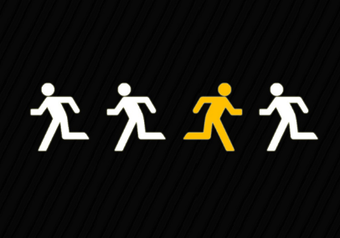
Ch. 5 Test Review
Introduction to Business

Slide 2
A business started by someone who accepted the risk of starting and running a business.
entrepreneurship

Slide 3
An independently owned business serving a limited geographic area.
Small Business

Slide 4
The money that is left over after a business has paid all the costs of producing its goods and services.
profit

Slide 5
A business that operates on the internet.
Virtual Business

Slide 6
A person who recognizes an opportunity and who organizes, manages and assumes the risk of a business enterprise, with the intent of increasing the value of the business.
entrepreneur

Slide 7
List 2 financial reasons that small businesses fail.
Starting with too little money.
Extending credit too freely.

Slide 8
The main reason small business owners fail is because
They extend credit too freely
They don’t work hard enough
They don’t have adequate managerial skills
They spend too much money

Slide 9
Dot.com companies do business using
The Internet
Cell phones
Bulk mail
Fax machines

Slide 10
Starting a business does not require
Hard work
Money
In-depth knowledge of the market
A dream

Slide 11
Entrepreneurs generally do not
Take risks
Seek work within an existing company
Start new businesses
Seek to make a profit

Slide 12
Small businesses do not
Employ more than half of the nation’s workforce
Dominate their industries
Serve a limited geographic area
Sometimes develop into major corporations

Slide 13
Another name for virtual business.
Dot com
E business

Slide 14
List 3 Characteristics of an Entrepreneur
Take charge
Self directed
Risk taker
Wants to work for themselves

Slide 15
List 3 Advantages of…
Entrepreneurship
Small Business
Satisfaction from taking risks
Show expertise and skills
Working from home
Gaining profit
Being your own boss
Offering services large businesses cannot
Ease of formation

Slide 16
What is the main reason entrepreneurships fail?
Money
  Poor money management

Slide 17
Give me an example of a service a small business can offer that large companies cannot offer.
Personal attention, they get to know you

Slide 18
Which is the most difficult to form:
Large or Small Business
Large business because there are so many more people that work for you.

Slide 19
Tell me about the Business Plan you wrote in class for your business that you created your Power Point for.
What did you name your business?
What product/service will you provide to the public?
Do you think your business would really be successful if you started it, or not? Explain

